Slide 1
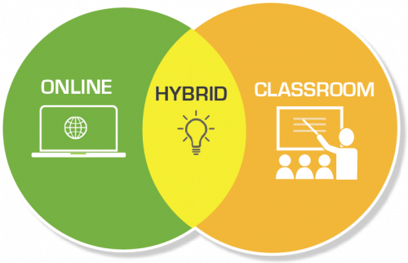
Kingsborough Faculty Responses Spring 2022
Data FIG
PRELIMINARY ANALYSIS [Draft]
October 19, 2022
Note: The use of this data is for assistance with our teaching. The data should not be distributed outside KCC and outside this scope.
Image Source: https://www.pcc.edu/instructional-support/hybrid-courses/

Slide 2
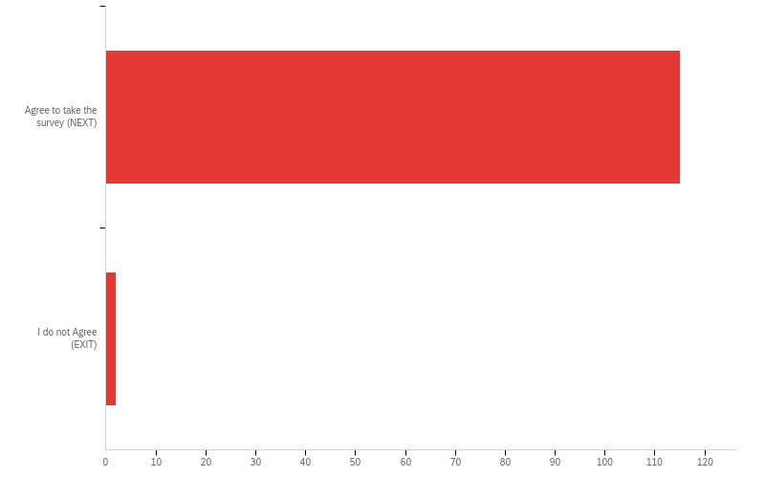
Consent Form - THE CITY UNIVERSITY OF NEW YORK KINGSBOROUGH COMMUNITY COLLEGE ORAL AND INTERNET-BASED INFORMED CONSENT SCRIPT Title of Research Study: Experience, Challenges, and Preferences with Remote Learning During and Post Covid-19 Pandemic: A Case Study with Students Enrolled in CUNY Kingsborough Community College [Spring 2021 and onward] Investigators Dorina Tila, Assistant Professor; Dawn Levy, Assistant Professor; Esther Michelle Gabay, Lecturer; Faith Fogelman, ASCW, Director; Peter Santiago, LMHC, Associate Director Introduction You are being asked to participate in this anonymous survey as part of a research study. The purpose of this study is to understand faculty and student learning experience and challenges with various teaching modalities. The results of this survey will be published openly (which means that all answers will be included anonymously in a file shared on CUNY Academic Works), analyzed in research publications, and/or presented at academic conferences, but individual survey respondents will in no way be identified in the data file on CUNY Academic Works, or in any publications or presentations resulting from the study. Procedures and Voluntary Participation Participation in the survey is voluntary. You may refuse to answer any questions that you do not want to answer and still remain in the study. Confidentiality The results of this participation will be confidential. Any identifiable information will be deleted, while unidentified data will be kept indefinitely. Time Required It may take about 6-8 minutes to complete the survey. Risks or Discomforts The risk from participating in this study is no more than what is encountered in everyday life. If you do not wish to answer a question, you can skip it and go to the next question. Benefits The information collected in surveys will help determine how to support faculty and students. Contact Your participation in this research is voluntary. If you have any questions, you can contact faculty Dorina Tila, Dorina.Tila@kbcc.cuny.edu; Phone: 718-368-4762. If you have any questions about your rights as a research participant or if you would like to talk to someone other than the researchers, you can contact CUNY Research Compliance Administrator at 646-664-8918 or hrpp@cuny.edu [Protocol # 2021-0443]. Consent You have read and understand the explanation provided. By taking this anonymous survey, you declare that to be over the age of 18 and you consent to take part in the study. Click Next to continue or Exit.

Slide 3
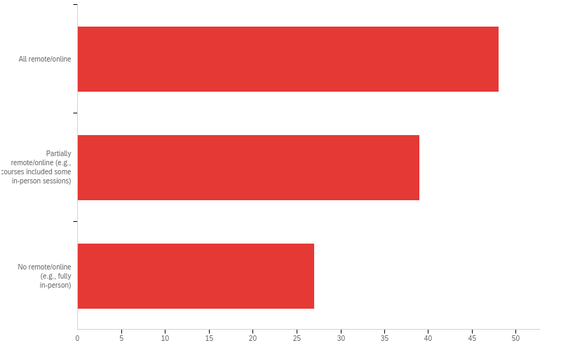
Q1 - What type of courses did you teach this semester?

Slide 4
Q1 - What type of courses did you teach this semester?
# | Answer | % | Count
1 | All remote/online | 42.11% | 48
2 | Partially remote/online (e.g., courses included some in-person sessions) | 34.21% | 39
3 | No remote/online (e.g., fully in-person) | 23.68% | 27
 | Total | 100% | 114

Slide 5
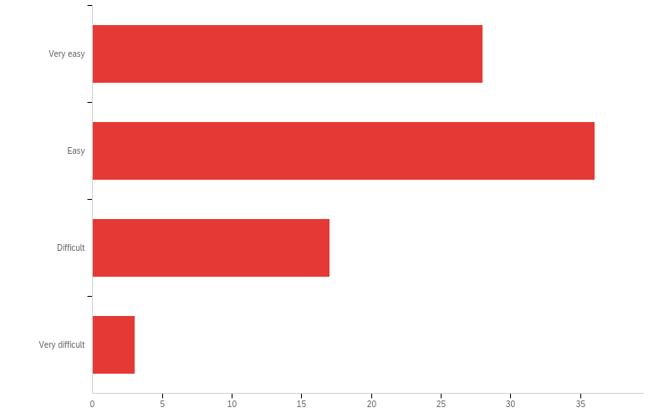
Q2 - How difficult did you find remote teaching during this semester

Slide 6
Q2 - How difficult did you find remote teaching during this semester

Slide 7
Q2 - How difficult did you find remote teaching during this semester
# | Answer | % | Count
2 | Very easy | 33.33% | 28
4 | Easy | 42.86% | 36
6 | Difficult | 20.24% | 17
7 | Very difficult | 3.57% | 3
 | Total | 100% | 84

Slide 8
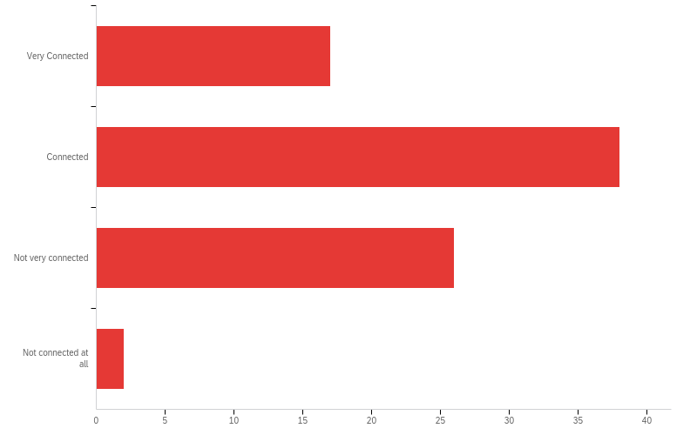
Q3 - How connected did you feel to your students through remote teaching during this semester

Slide 9
Q3 - How connected did you feel to your students through remote teaching during this semester
# | Answer | % | Count
1 | Very Connected | 20.48% | 17
2 | Connected | 45.78% | 38
3 | Not very connected | 31.33% | 26
4 | Not connected at all | 2.41% | 2
 | Total | 100% | 83

Slide 10
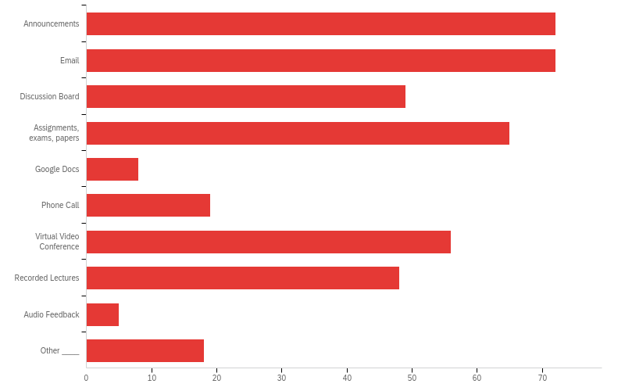
Q4 - Instructor presence is a major factor impacting student success in online classes. Which of the following helped you maintain your instructor presence and feel connected with your students? (check all that apply)

Slide 11
Q4 - Instructor presence is a major factor impacting student success in online classes. Which of the following helped you maintain your instructor presence and feel connected with your students? (check all that apply)

Slide 12
Q4 - Instructor presence is a major factor impacting student success in online classes. Which of the following helped you maintain your instructor presence and feel connected with your students? (check all that apply)
# | Answer | % | Count
1 | Announcements | 17.48% | 72
2 | Email | 17.48% | 72
3 | Discussion Board | 11.89% | 49
4 | Assignments, exams, papers | 15.78% | 65
5 | Google Docs | 1.94% | 8
6 | Phone Call | 4.61% | 19
7 | Virtual Video Conference | 13.59% | 56
8 | Recorded Lectures | 11.65% | 48
9 | Audio Feedback | 1.21% | 5
10 | Other ____ | 4.37% | 18
# | Answer | % | Count
 | Total | 100% | 412

Slide 13
Q4 - Instructor presence is a major factor impacting student success in online classes. Which of the following helped you maintain your instructor presence and feel connected with your students? (check all that apply)
Q3_10_TEXT - Other ____
Other ____ - Text
texts
Texts
Original Lectures supplementing the Texts - plus encouraging optional papers & comments
Slack text messaging app
Text messages via Remind
video feedback
Live Zoom lectures
texting
in-person meetings
Weekly in person field trips
Offered a variety of drop in office hours

Slide 14
Q4 - Instructor presence is a major factor impacting student success in online classes. Which of the following helped you maintain your instructor presence and feel connected with your students? (check all that apply)
Q3_10_TEXT - Other ____
Other ____ - Text
Class WhatsApp group chat
Texts when necessary
Group text messages...
monthly journal entries by students and remind.
Discord, other venues to keep in touch with students

Slide 15
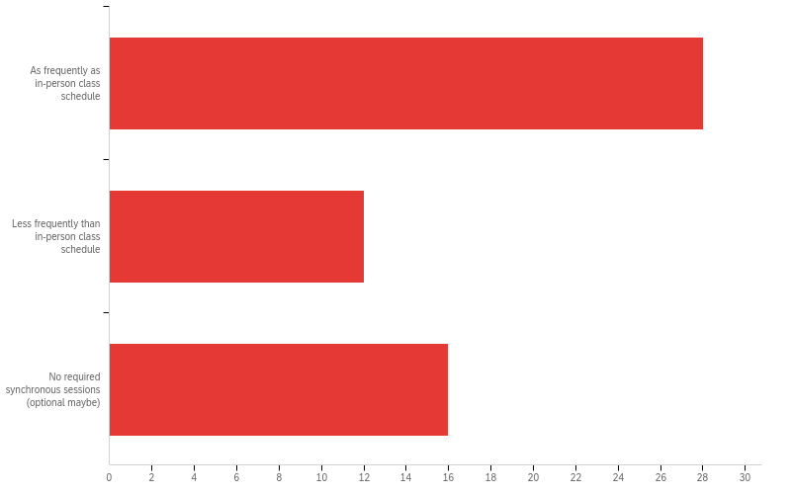
Q5 - How frequently did you conduct required synchronous sessions during this semester?

Slide 16
Q5 - How frequently did you conduct required synchronous sessions during this semester?
# | Answer | % | Count
1 | As frequently as in-person class schedule | 50.00% | 28
2 | Less frequently than in-person class schedule | 21.43% | 12
3 | No required synchronous sessions (optional maybe) | 28.57% | 16
 | Total | 100% | 56

Slide 17
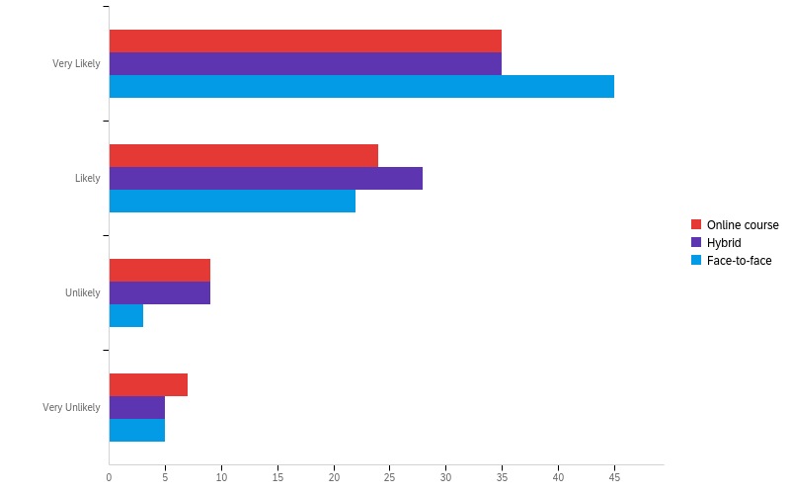
Q6 - What type of teaching modalities would best promote your course outcomes?

Slide 18
Q6 - What type of teaching modalities would best promote your course outcomes?
# | Question | Very Likely |  | Likely |  | Unlikely |  | Very Unlikely |  | Total
1 | Online course | 46.67% | 35 | 32.00% | 24 | 12.00% | 9 | 9.33% | 7 | 75
2 | Hybrid | 45.45% | 35 | 36.36% | 28 | 11.69% | 9 | 6.49% | 5 | 77
3 | Face-to-face | 60.00% | 45 | 29.33% | 22 | 4.00% | 3 | 6.67% | 5 | 75

Slide 19
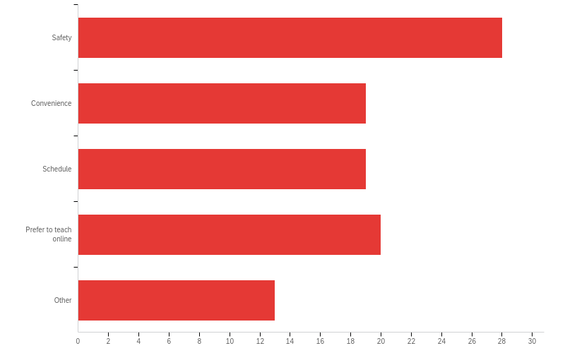
Q7 - What best describes your reasons for teaching mostly online courses (check top 2)

Slide 20
Q7 - What best describes your reasons for teaching mostly online courses (check top 2)
# | Answer | % | Count
1 | Safety | 28.28% | 28
2 | Convenience | 19.19% | 19
3 | Schedule | 19.19% | 19
4 | Prefer to teach online | 20.20% | 20
5 | Other | 13.13% | 13
 | Total | 100% | 99

Slide 21
Q7 - What best describes your reasons for teaching mostly online courses (check top 2)
Q6a_5_TEXT - Other
Other - Text
Students seem to prefer online classes because they have day jobs
Student need
It's the preference of a great majority of my & all pupils in this COVID setting and given their heavy work & family responsibilities
Student request
Time is spent more efficiently due to no need for a commute. There is also the eradication of distracting classroom antics such as wanton cellphone use and lateness (for an asynchronous class) is not an issue. There is also greater flexibility in administering exams.
Adaptability and flexibility for students
Medical Issues
I did not say that I had taught mostly online courses.
Face to face did not fill.

Slide 22
Q7 - What best describes your reasons for teaching mostly online courses (check top 2)
Q6a_5_TEXT - Other
Other - Text
Students' preference
Benefits to students
Student Preference-registration
I did not teach mostly online courses: 2 online, 2 in-person

Slide 23
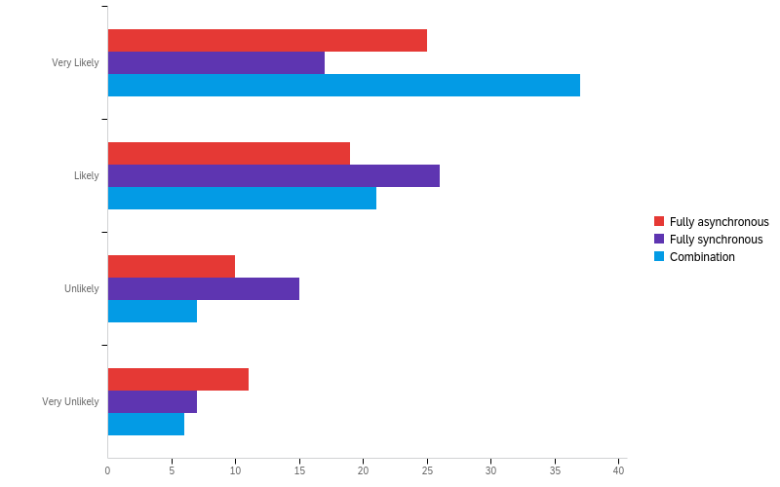
Q8 - What type of online courses would best promote your course outcomes?

Slide 24
Q8 - What type of online courses would best promote your course outcomes?
# | Question | Very Likely |  | Likely |  | Unlikely |  | Very Unlikely |  | Total
1 | Fully asynchronous | 38.46% | 25 | 29.23% | 19 | 15.38% | 10 | 16.92% | 11 | 65
2 | Fully synchronous | 26.15% | 17 | 40.00% | 26 | 23.08% | 15 | 10.77% | 7 | 65
3 | Combination | 52.11% | 37 | 29.58% | 21 | 9.86% | 7 | 8.45% | 6 | 71

Slide 25
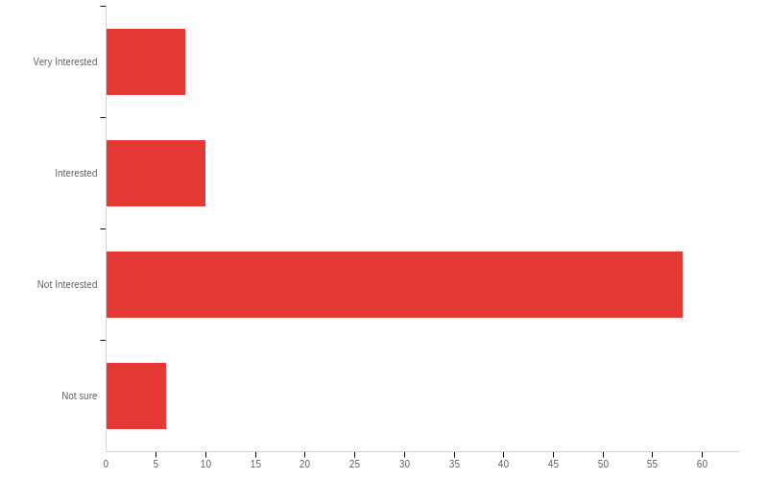
Q9 - How interested would you be in teaching a HyFlex course if available (where the class would take place on campus and students could choose to attend either in-person or via Zoom)?

Slide 26
Q9 - How interested would you be in teaching a HyFlex course if available (where the class would take place on campus and students could choose to attend either in-person or via Zoom)?
# | Answer | % | Count
1 | Very Interested | 9.76% | 8
2 | Interested | 12.20% | 10
3 | Not Interested | 70.73% | 58
4 | Not sure | 7.32% | 6
 | Total | 100% | 82

Slide 27
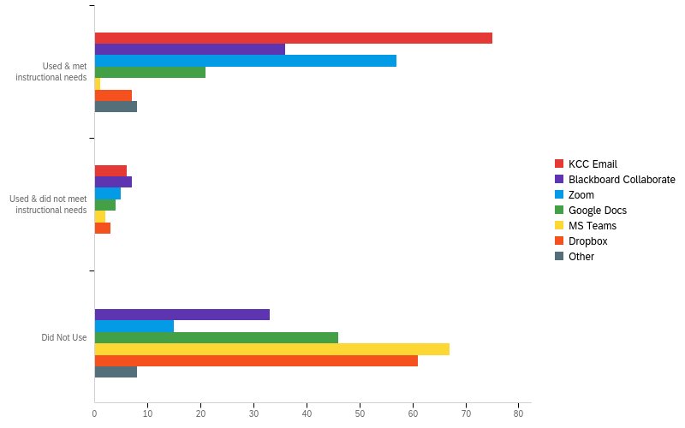
Q10 - What has been your experience using the following tools to communicate with your students

Slide 28
Q10 - What has been your experience using the following tools to communicate with your students
# | Question | Used & met instructional needs |  | Used & did not meet instructional needs |  | Did Not Use |  | Total
1 | KCC Email | 92.59% | 75 | 7.41% | 6 | 0.00% | 0 | 81
2 | Blackboard Collaborate | 47.37% | 36 | 9.21% | 7 | 43.42% | 33 | 76
3 | Zoom | 74.03% | 57 | 6.49% | 5 | 19.48% | 15 | 77
4 | Google Docs | 29.58% | 21 | 5.63% | 4 | 64.79% | 46 | 71
5 | MS Teams | 1.43% | 1 | 2.86% | 2 | 95.71% | 67 | 70
6 | Dropbox | 9.86% | 7 | 4.23% | 3 | 85.92% | 61 | 71
7 | Other | 50.00% | 8 | 0.00% | 0 | 50.00% | 8 | 16

Slide 29
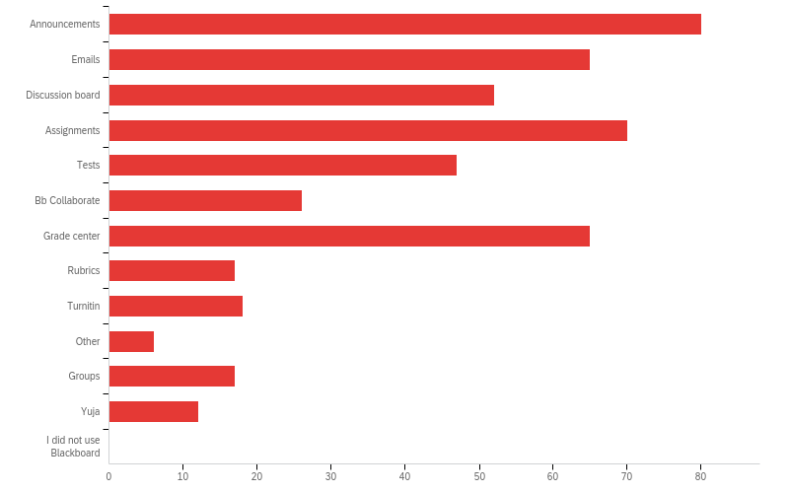
Q11 - Which Blackboard tools did you did you use most often? [Check all that apply]

Slide 30
Q11 - Which Blackboard tools did you did you use most often? [Check all that apply]

Slide 31
Q11 - Which Blackboard tools did you did you use most often? [Check all that apply]
# | Answer | % | Count
1 | Announcements | 16.84% | 80
2 | Emails | 13.68% | 65
3 | Discussion board | 10.95% | 52
4 | Assignments | 14.74% | 70
5 | Tests | 9.89% | 47
6 | Bb Collaborate | 5.47% | 26
7 | Grade center | 13.68% | 65
8 | Rubrics | 3.58% | 17
9 | Turnitin | 3.79% | 18
10 | Other | 1.26% | 6
11 | Groups | 3.58% | 17
# | Answer | % | Count
12 | Yuja | 2.53% | 12
13 | I did not use Blackboard | 0.00% | 0
 | Total | 100% | 475

Slide 32
Q11 - Which Blackboard tools did you did you use most often? [Check all that apply]
Q11_10_TEXT - Other
Other - Text
Course Content
Journals
SafeAssign, Blogs, Journals
Course Content docs
Blogs
Hypothesis Annotation

Slide 33
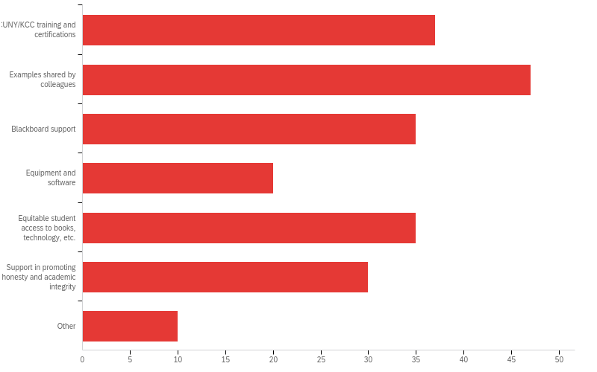
Q13 - What activities, resources, and/or supports do you think would help you prepare to teach in future online courses? [select all that apply]

Slide 34
Q13 - What activities, resources, and/or supports do you think would help you prepare to teach in future online courses? [select all that apply]

Slide 35
Q13 - What activities, resources, and/or supports do you think would help you prepare to teach in future online courses? [select all that apply]
# | Answer | % | Count
1 | CUNY/KCC training and certifications | 17.29% | 37
2 | Examples shared by colleagues | 21.96% | 47
3 | Blackboard support | 16.36% | 35
4 | Equipment and software | 9.35% | 20
5 | Equitable student access to books, technology, etc. | 16.36% | 35
6 | Support in promoting honesty and academic integrity | 14.02% | 30
7 | Other | 4.67% | 10
 | Total | 100% | 214

Slide 36
Q13 - What activities, resources, and/or supports do you think would help you prepare to teach in future online courses? [select all that apply]
Q13- other option_7_TEXT - Other
Other - Text
Greater support from departmental & administrative colleagues, and department chairs; also greater interaction with and help for students from the fine Library staffers in guiding pupils' research and securing related books and articles and relevant indexes
Students need their own training with basic computer skills, which is lacking.
Students get an orientation and workshop on Bb and how to use it's features. FLEX students were very much more prepared for online learning versus students who chose online classes bc of technicalities.
I feel really comfortable teaching online but ideas from colleagues and more fully exploring Bb might help me expand my repertoire
using nationally recognized rubrics like QM and OSCQR
None of these
simple how to guide
Students prefer zoom to Blackboard Collaborate. Access to the breakout groups function in zoom can be very helpful.
Other - Text
I am already trained and certified. NA

Slide 37
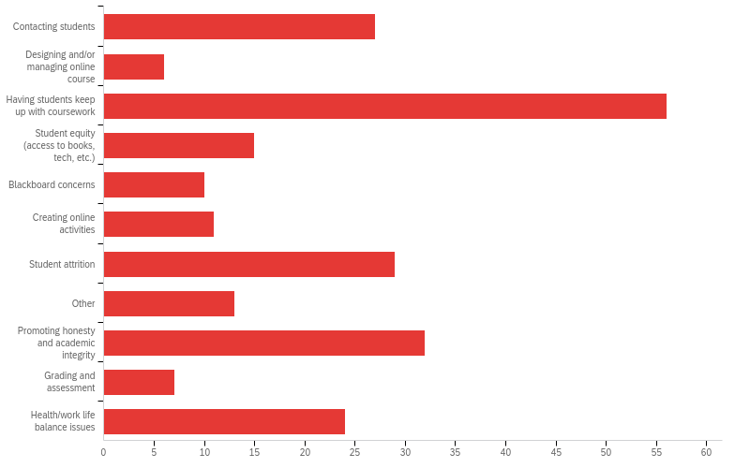
Q14 - What were some challenges you experienced this semester [select all that apply]

Slide 38
Q14 - What were some challenges you experienced this semester [select all that apply]

Slide 39
Q14 - What were some challenges you experienced this semester [select all that apply]
# | Answer | % | Count
1 | Contacting students | 11.74% | 27
2 | Designing and/or managing online course | 2.61% | 6
3 | Having students keep up with coursework | 24.35% | 56
4 | Student equity (access to books, tech, etc.) | 6.52% | 15
5 | Blackboard concerns | 4.35% | 10
6 | Creating online activities | 4.78% | 11
7 | Student attrition | 12.61% | 29

Slide 40
Q14 - What were some challenges you experienced this semester [select all that apply]
# | Answer | % | Count
8 | Other | 5.65% | 13
9 | Promoting honesty and academic integrity | 13.91% | 32
10 | Grading and assessment | 3.04% | 7
11 | Health/work life balance issues | 10.43% | 24
 | Total | 100% | 230

Slide 41
Q14 - What were some challenges you experienced this semester [select all that apply]
Q14 - other option_8_TEXT - Other
Other - Text
online cheating is out of hand
Assuring pupils' regular timely upkeep with course assignments & requirements
Students' lack of basic computer skills
Posting recorded lectures from Zoom to Blackboard
I would like to add that in-person course (prior to Covid19) student attrition was a problem. But with the flexibility of asynchronous course, it has been easier for them to make up the work.
Student mental health concerns
Easier access to KCC tutoring
I think reaching out to students via email, phone, and Starfish is fine but students don't always respond and sometimes disappear. But this was true with in-person, too!
none of these
Creating groups was a disaster!

Slide 42
Q14 - What were some challenges you experienced this semester [select all that apply]
Q14 - other option_8_TEXT - Other
Other - Text
While teaching an online ENG 24 course, I found that many of the students worked full-time and then expend that i would be willing to be extra flexible with deadlines. I tried to flex a bit, but after a while it becomes clear that many students were contacting me to offer excuses rather than actually submitting assignments.
Student Time Management

Slide 43
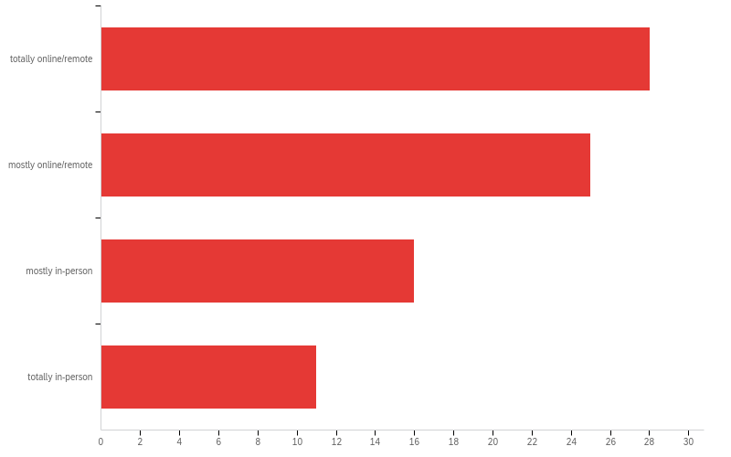
Q15 - If health and safety requirements, facilities, operations, and academic/administrative needs permit, I would prefer the following instructional mode for my courses next semester:

Slide 44
Q15 - If health and safety requirements, facilities, operations, and academic/administrative needs permit, I would prefer the following instructional mode for my courses next semester:

Slide 45
Q15 - If health and safety requirements, facilities, operations, and academic/administrative needs permit, I would prefer the following instructional mode for my courses next semester:
# | Answer | % | Count
1 | totally online/remote | 31.25% | 10
2 | mostly online/remote | 34.38% | 11
3 | mostly in-person | 15.63% | 5
4 | totally in-person | 18.75% | 6
 | Total | 100% | 32

Slide 46
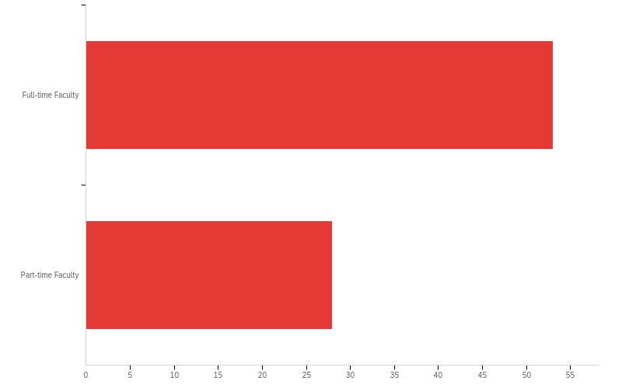
Q16 - What best describes you?
Answer | % | Count
Full-time Faculty | 65.43% | 53
Part-time Faculty | 34.57% | 28
Total | 100% | 81

Slide 47
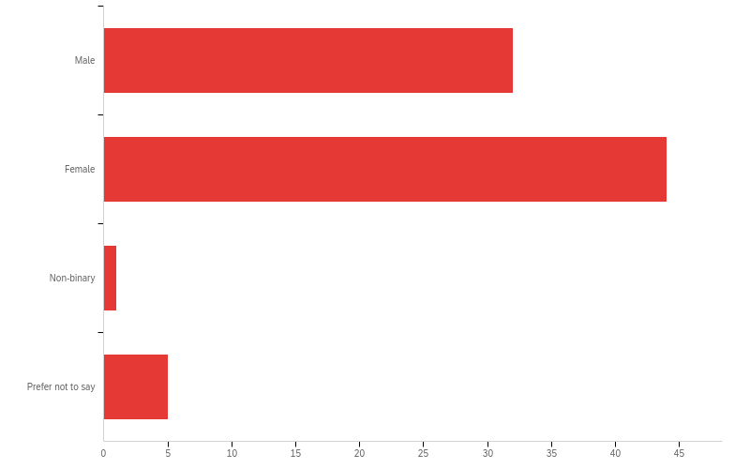
Q17 - What is your gender?

Slide 48
Q17 - What is your gender?
# | Answer | % | Count
1 | Male | 45.45% | 15
2 | Female | 48.48% | 16
3 | Non-binary | 0.00% | 0
4 | Prefer not to say | 6.06% | 2
 | Total | 100% | 33

Slide 49
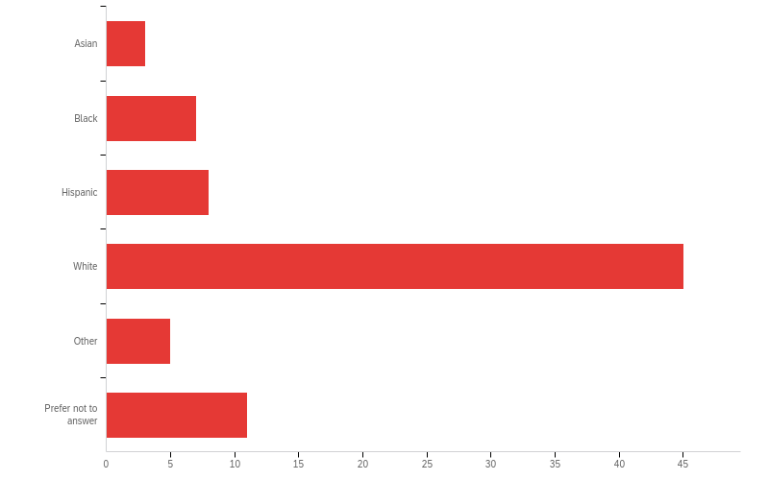
Q18 - Please report your race/ethnicity

Slide 50
Acknowledgments
Thank you to the dedication and contribution of KCC faculty of “Using Data to Support Teaching and Learning” KCTL Faculty Interest Group and the KCC Office of Institutional Effectiveness for designing, delivering, and analyzing the data of these surveys.

