Slide 1
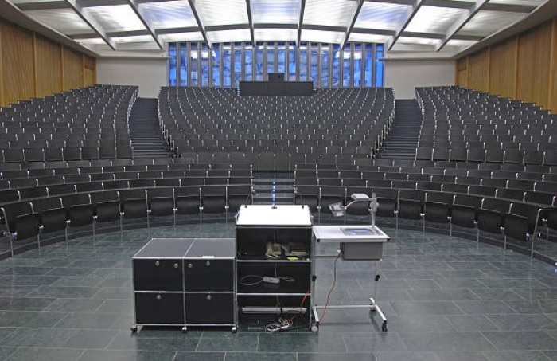
KCC Student & Faculty Surveys Spring 2020 through Spring 2022
Using Data to Support Teaching and Learning FIG
Draft
November 3, 2022
IRB File #2021-0387. Title: Experience, Challenges, and Preferences with Remote Learning During Covid-19 Pandemic: A Case Study with Faculty and Students in CUNY Kingsborough Community College [Spring 2020 - Fall 2020].

Slide 2
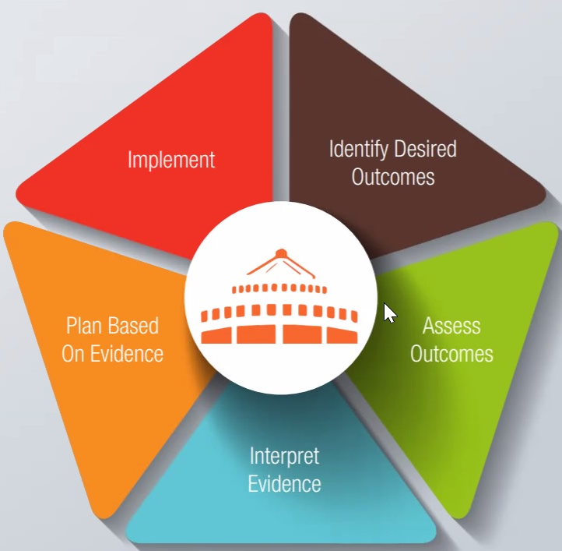
1. Issues Identified
What are faculty and students’ experiences and challenges during
Emergency Remote Instruction (ERI) during Spring 2020
Remote learning during Fall 2020, Spring 2021, Fall 2021, and Spring 2022

Slide 3
2. Access Data
Qualitative Assessment
Data Faculty Interest Group (FIG) & the Office of Institutional Effectiveness designed and delivered Student & Faculty Survey:
Student Respondents
Spring ‘20: 867
Fall ‘20: 1,174
Spring ‘21: 1,110
Fall ‘21: 721
Spring ‘22: 530
Faculty Respondents
Spring ‘20: 198
Spring ‘21: 119
Spring ’22 115

Slide 4
3. Interpret Evidence
Students’ easiness with remote learning has increased.
Students’ easiness with remote learning might decrease withdrawals and increase the likelihood of enrolling in online courses in the future.
Feeling of connected with the professor seems to improve easiness in remote learning.
Students’ feeling of connection with faculty seems to improve by using Bb tools (announcements, discussions, etc.).
High interest is shown in online teaching modality and in fully asynchronous and/or combination.
Notes:
1. Issue to address that in Fall 2020 students still felt difficulty with online learning.
2. Data FIG looked at what may have improved online experience (use of Bb tools, connectivity to faculty).
3. We will inquire in Spring 2021 what could possibly be the interest in online learning – safety issues, scheduling, convenience, or preference in online learning, etc.

Slide 5
4. Plan Based on Evidence
Actionable Data
Learn and Share with Faculty & Institution
Learn what improves student learning (e.g., use of Bb tools, connectivity to faculty).
Learn what helps meeting student & faculty preferences & promoting of learning outcomes

Slide 6
Ethnicity/Race/Gender Similar samples
Samples across the five semesters appear similar. They seem a representative sample of KCC student population based on Race/Ethnicity, but not representative based on gender. Higher percentage of women responded to the surveys.
Source: https://www.collegefactual.com/colleges/cuny-kingsborough-community-college/student-life/diversity/

Slide 7
Remote Learning Easiness
 | SP 2020 | Fall 2020 | SP 2021 | Fall 2021 | SP 2022
Easy/Very Easy | 371 | 467 | 604 | 488 | 326
Hard / Very Hard | 490 | 707 | 382 | 152 | 102
Total | 861 | 1174 | 986 | 640 | 428
Finding 1: Students responses show an improvement in easiness with Remote Learning and reaching a plateau in Fall 2021 and Spring 2022.
Most of respondents reported difficulty during Spring 2020, while by Fall 2021-Spring 2022, most of respondents considered remote learning as easy or very easy.

Slide 8
Remote Learning Easiness
 | SP 2020 | Fall 2020 | SP 2021 | Fall 2021 | SP 2022
Easy/Very Easy | 371 | 467 | 604 | 488 | 326
Hard / Very Hard | 490 | 707 | 382 | 152 | 102
Total | 861 | 1174 | 986 | 640 | 428
Finding 1b: There seems to be no difference in easiness with remote learning during Fall 2021-Spring 2022. What can be done to increase this number in the future?

Slide 9
Withdrawals Students’ Responses
 | Fall 2020 | Spring 2021 | Fall 2021 | Spring 2022
0 | 655 | 676 | 449 | 301
1 | 137 | 110 | 62 | 54
2 | 50 | 32 | 33 | 10
3 | 35 | 17 | 14 | 11
4 | 13 | 15 | 5 | 4
5 | 11 | 13 | 4 | 1
6 or more | 14 | 5 | 4 | 2
Total | 915 | 868 | 571 | 383
Finding 2: Students report a decrease in withdrawals from Fall 2020 to Spring 2022.

Slide 10
Remote Learning Connection with the Professor
 | Fall 2020 | SP 2021 | Fall 2021 | SP 2022
Very connected | 149 | 259 | 209 | 153
Connected | 419 | 424 | 283 | 199
Not very connected | 375 | 228 | 113 | 63
Not connected | 230 | 76 | 36 | 14
Total | 1173 | 987 | 641 | 429
Finding 3: Students report to have become more connected with their professor in online learning from Fall ‘20 to Spring ‘22.

Slide 11
Withdrawals Connection with Professor
Finding 4a: Students feeling connected with their professor report lower course withdrawals.

Slide 12
Remote Learning & Connection Disaggregating Data
Finding 4b: Students who felt connected with the professor had an easier time with remote learning than students who felt disconnected (Fall 2021 Survey).

Slide 13
Remote Learning & Enrollment Disaggregating Data
Finding 4c: Students who had an easier time with remote learning express more likelihood to enroll in Online Courses (Fall 2021 Survey).

Slide 14
Connection with Professors What Helps
Finding 5: Students report several ways that helps them feel connected with the professor (means of communication, assessment, and lectures).
Over time, the emphasis in discussion board has increased.

Slide 15
Various Learning Modalities Students’ Preference
Finding 6: Students consistently report an increasing preference for totally online/remote learning.

Slide 16
Remote Learning Reasons for Enrolling
Finding 6a: In Spring ‘22, students indicate convenience and schedule as the top reasons for their preference in online learning.
Finding 6b: In Spring ‘22, students are less concerned with safety as a reason for the online course enrollment.

Slide 17
Various Online Formats Students’ likelihood to enroll
Finding 7a: Students report to be more likely to register in asynchronous online courses (over 57% of students report it likely).
Findings 7b: These results seem similar across these two semesters.

Slide 18
HyFlex Students’ likelihood to enroll (1)
Finding 8a: Students report an interest in Hyflex courses. [[Faculty’s interest seems to have decreased --- check]]

Slide 19
HyFlex Students’ preferences (2)
Finding 8b: Online courses seem to be the top choice for students, while Hyflex is the 2nd best.

Slide 20
Improve Learning Technology Updates
Finding 9a: Students report that most beneficial to their learning would be updates in: a device (desktop, laptop, tablet) and connectivity (internet/wifi). With time, the need for the latter has decreased, while for the former (device) has slightly increased (SP22).

Slide 21
Improve Learning Technology Updates
Finding 9b: Even though students report an increasing need for an updated device, with time, they also show that a higher percentage own their own device. “Is the owned device not appropriate?”

Slide 22
Summary of Findings
Finding 1: Easiness with remote learning has increased
Finding 2: Reported withdrawals have decreased
Finding 3: Connection with professor in remote learning has increased
Finding 4: Students feeling connected report lower withdrawals; easier time with remote learning, and more likelihood to enroll in online courses
Finding 5: Students report several ways that helps them feel connected with the professor (means of communication, assessment, and lectures). Over time, the emphasis in discussion board has increased
Finding 6: Students are more likely to enroll in online courses. Students’ convenience and schedule are selected as top reasons for online course enrollment, while before Spring ‘22 it was safety.
Finding 7: Students are more likely to enroll in asynchronous online courses
Finding 8: There is interest in enrolling in Hyflex course
Finding 9: Most beneficial to students’ learning are reported updates in a device (desktop, laptop, tablet) and connectivity (internet/wifi). With time, the need for the latter has decreased, while need for the former (device) has increased

Slide 23
FACULTY SURVEY
198 faculty respondents during Spring 2020
119 faculty respondents during Spring 2021
115 faculty responded during Spring 2022

Slide 24
Remote Learning & Teaching Student & Faculty Easiness
SP 2022 | SP 2022 | Students SP'22 | Faculty | Faculty SP'22
Very Easy | 102 | 24% | 28 | 33%
Easy | 224 | 52% | 36 | 43%
Hard | 85 | 20% | 17 | 20%
Very Hard | 17 | 4% | 3 | 4%
Total | 428 | 100% | 84 | 100%
Finding 11a: In Spring 2022, students and faculty report the same easiness with remote learning/teaching (76% E&VE) with faculty being slightly more confident.

Slide 25
Remote Learning & Teaching Student & Faculty Easiness
SP 2021 | Students | Students (%) | Faculty | Faculty (%)
Very Easy | 194 | 20% | 16 | 16%
Easy | 410 | 42% | 40 | 39%
Hard | 285 | 29% | 43 | 42%
Very Hard | 97 | 10% | 4 | 4%
Total | 986 | 100% | 103 | 100%
Finding 11b: In Spring 2021, students report more easiness with remote learning compared to faculty (64% E&VE compared to 55%).

Slide 26
Remote Learning & Teaching Student & Faculty Connection
SP 2022 | Student | Student | Faculty | Faculty
Very connected | 153 | 36% | 17 | 20%
Connected | 199 | 46% | 38 | 46%
Not very connected | 63 | 15% | 26 | 31%
Not connected | 14 | 3% | 2 | 2%
Total | 429 | 100% | 83 | 100%
Finding 12: In Spring 2022, students’ feeling of connection with professor is higher (more than Spring ’21) than faculty’s feeling of connection with students.

Slide 27
Remote Learning & Teaching Student & Faculty Connection
SP 2021 | Student | Student | Faculty | Faculty
Very connected | 259 | 26% | 7 | 7%
Connected | 424 | 43% | 54 | 52%
Not very connected | 228 | 23% | 37 | 36%
Not connected | 76 | 8% | 5 | 5%
Total | 987 | 100% | 103 | 100%
Finding 12: In Spring 2021, students’ feeling of connection with professor is higher than faculty’s feeling of connection with students.

Slide 28
Connection in Online Class What Helps
Finding 13: Overall, students and faculty consider similar things affecting their connection student-professor. Students seem to consider Discussion Boards and Emails slightly more important that faculty.

Slide 29
Connection in Online Class What Helps
Finding 13: Overall, students and faculty consider similar things affecting their connection student-professor. Students seem to consider Discussion Boards and Emails slightly more important that faculty.

Slide 30
Various Learning Modalities Faculty Perspective
Finding 14: Faculty consider in-person teaching modality as the best to promote course outcomes.

Slide 31
Remote Learning Reasons for Enrolling
Finding 15a: Students identify Schedule and Convenience; while Faculty report Safety and Preference to Teach Online as top reasons.
Finding 15b: Safety is less of a concern in Spring 22 compared to Spring 21.

Slide 32
Summary of Findings
Finding 11a: In Spring 2022, students and faculty report the same easiness with remote learning/teaching (76% E&VE) with faculty being slightly more confident.
Finding 11b: In Spring 2021, students report more easiness with remote learning compared to faculty (64% E&VE compared to 55%).
Finding 12: In Spring 2022, students’ feeling of connection with professor is higher than faculty’s feeling of connection with students.
Finding 13: Overall, students and faculty consider similar things affecting their connection student-professor. Students seem to consider Discussion Boards and Emails slightly more important that faculty.
Finding 14: Faculty consider in-person teaching modality as the best to promote course outcomes.
Finding 15a: Students identify Schedule and Convenience; while Faculty report Safety and Preference to Teach Online as top reasons. Safety is less of a concern in Spring 22 compared to Spring 21.

Slide 33
5. Conclusion & Vision of Implementation
Continuous Process - Cycle
Improve students’ learning experience
Increase student and faculty connectivity (online presence)
Changes of students’ preferences on teaching modalities across time & demographics
Faculty response on teaching modalities & promoting of course outcomes
Identify challenges and possible actions

Slide 34
Acknowledgments
Prepared with the dedication and contribution of KCTL “Using Data to Support Teaching and Learning” in designing, delivering, and analyzing the data of these surveys.
Thank you for the support of the KCC Office of Institutional Effectiveness, KCTL, and KCeL.

