Slide 1
Other surveys

Slide 2
Active Minds surveyed 2,086 college students regarding the impact of COVID-19 on their mental health in April 2020. Here is what we learned: https://www.activeminds.org/wp-content/uploads/2020/04/Student-Survey-Infographic.pdf How has COVID-19 impacted your mental health?
 | All Students | College Students | High School Students
Worsened Significantly | 18% | 20% | 12%
Worsened | 57% | 60% | 48%
Unchanged | 13% | 11% | 21%
Improved | 10% | 9% | 17%
Improved significantly | 1% | 1% | 2%

Slide 3
If applicable, what has been most difficult about the stay-at-home orders and recommendations, with regard to your current living space? (select all that apply)
 | All Students | College Students | High School Students
Staying focused on school/work despite distractions | 81% | 85% | 71%
Navigating “small” annoyances/ inconveniences | 49% | 51% | 46%
Avoiding arguments or negativity | 46% | 49% | 44%
Finding privacy/quiet space | 45% | 48% | 36%
Feeling heard and understood by others | 35% | 36% | 30%
Balancing personal and social time | 33% | 37% | 28%
None of the above have been challenging | 4% | 3% | 7%
Other* | 2% | 2% | 2%

Slide 4
In which of the following additional ways, if any, has COVID-19 impacted your life? All apply
 | All Students |  | College Students | High School Students
Stress or anxiety | 87% | 91% |  |  | 74%
Disappointment or sadness | 78% | 80% |  |  | 74%
Loneliness or isolation | 42% | 48% |  |  | 26%
Financial Setback | 42% | 48% |  |  | 26%
Relocation | 39% | 56% |  |  | 2%
Illness (myself or a loved one) | 7% | 6% |  |  | 9%
Loss of a loved one | 4% | 3% |  |  | 5%
None of the above | 4% | 2% |  |  | 8%

Slide 5
What has been most stressful, if anything, for you during COVID-19 overall? (choose one)
 | All Students | College Students | High School Students
Having trouble focusing on studies and/or work | 38% | 42% | 27%
Feeling disconnected from friends and/or loved ones | 28% | 25% | 42%
Feeling unhappy in my living space | 10% | 11% | 10%
Finding joy while coping with the pandemic | 10% | 10% | 9%
Having your basic needs met (i.e. food, housing, job, and/or financial security) | 7% | 6% | 3%
Limited access to mental health services (i.e. therapy or medication) | 2% | 2% | 3%
Other* | 3% | 3% | 3%
I have not experienced any stress | 2% | 1% | 3%

Slide 6
Which of the following self-care habits have been challenging to maintain so far during COVID-19? (select all that apply)
 | All Students | College Students | High School Students
Maintaining a routine | 74% | 76% | 68%
Getting enough physical activity | 70% | 73% | 62%
Staying connected with others | 59% | 63% | 55%
Eating well | 56% | 58% | 50%
Getting enough sleep | 51% | 52% | 48%
Managing news/social media intake | 48% | 51% | 40%
Self-care has not been challenging | 5% | 4% | 8%
Other* | 3% | 3% | 2%

Slide 7
On a scale of 1-10, how hopeful are you about achieving your school-related goals and your future job prospects (1=not at all hopeful, 10=extremely hopeful)?
 | All Students | College Students | High School Students
10 (extremely hopeful) | 13% | 12% | 17%
6-9 (hopeful) | 58% | 57% | 60%
5 (neutral) | 11% | 11% | 9%
2-4 (unhopeful) | 16% | 18% | 12%
1 (not at all hopeful) | 3% | 3% | 2%

Slide 8
What do you think is most important for school leadership to be thinking about in the short term and long term for student mental health during and after the pandemic?
Academic support Leniency, accommodations, flexibility
Mental health resources Increased investment in counseling and coping resources
Soft skills Empathy, compassion, communication, understanding, validation
Provide opportunities for social connection Replacing cancelled events/services/classes with virtual ones
Engage in long-term planning Being prepared to help students heal and recover when they return; putting in place improved practices and protocols to more easily pivot to remote learning in case of another similar crisis

Slide 9
BrightSpot: Taking the Pulse of Students During COVID-19 https://www.brightspotstrategy.com/whitepaper/student-experience-snapshot-covid-19/ Brightspot surveyed a generally representative sample of 500 students nationally in late April
After the pandemic and school resumes in face-to-face, how likely are you to be taking online courses, hybrid, online student services, etc…
More likely, same, less likely not sure
28% of students say they are more likely to use online student services in the future and 28% say they are less likely

Slide 10
Simpson Scarborough - Higher Ed and COVID-19 National Student Survey https://cdn2.hubspot.net/hubfs/4254080/SimpsonScarborough%20National%20Student%20Survey%20.pdf
Highschool
89% Still planning to enroll at a traditional, 4-year college/university in Fall 2020.
8% Decided not to attend a traditional, 4-year college/ university in Fall 2020 due to the COVID-19 outbreak in the US.
3% Decided not to attend a traditional, 4-year college/ university in Fall 2020 for a reason other than COVID-19.
Could we have a similar question about transferring students to 4-year colleges.
Do you have access to a quiet place to study
Yes, it's reliable Yes, but it's NOT reliable No, I do not have access

Slide 11
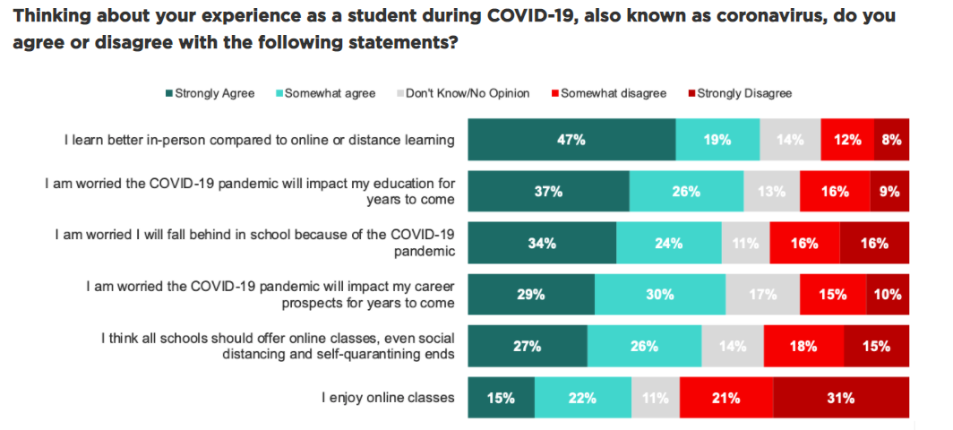
https://www.crpe.org/thelens/students-count-highlights-covid-19-student-surveys

Slide 12
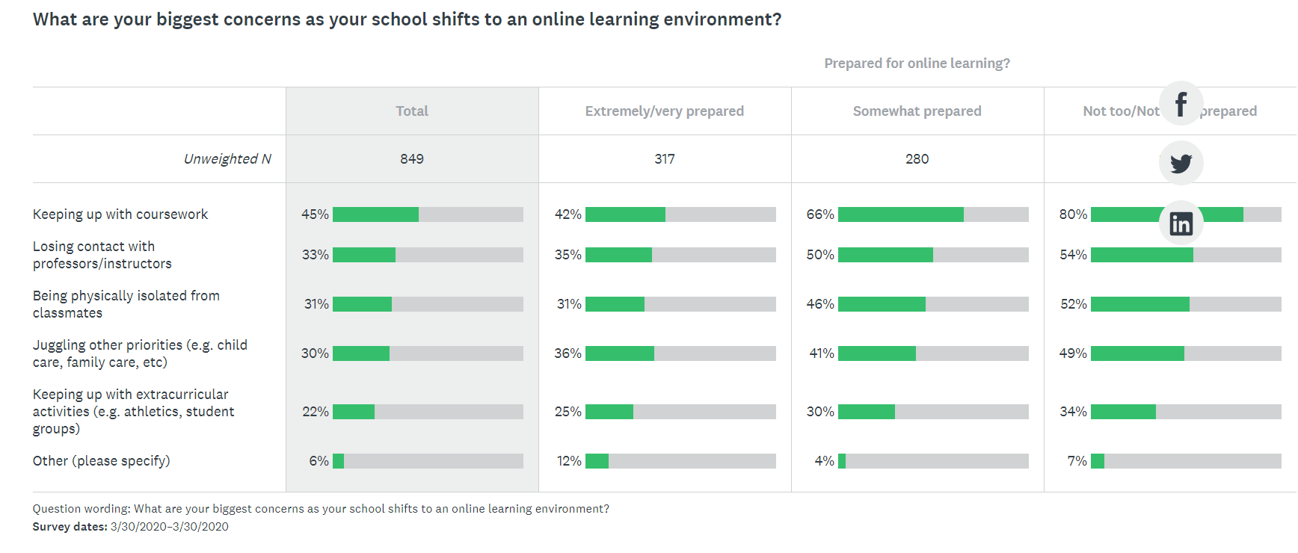
CALIFORNIA STUDENT AID COMMISSION COVID-19 Student Survey https://www.csac.ca.gov/sites/main/files/file-attachments/2020_covid19_student_survey.pdf?1594172054

Slide 13
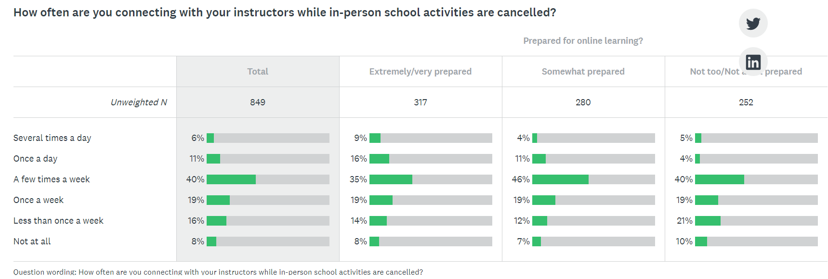
CALIFORNIA STUDENT AID COMMISSION COVID-19 Student Survey https://www.csac.ca.gov/sites/main/files/file-attachments/2020_covid19_student_survey.pdf?1594172054

Slide 14
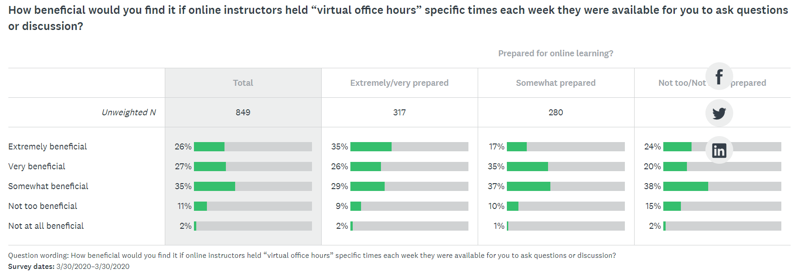
CALIFORNIA STUDENT AID COMMISSION COVID-19 Student Survey https://www.csac.ca.gov/sites/main/files/file-attachments/2020_covid19_student_survey.pdf?1594172054

Slide 15
CALIFORNIA STUDENT AID COMMISSION COVID-19 Student Survey https://www.csac.ca.gov/sites/main/files/file-attachments/2020_covid19_student_survey.pdf?1594172054

Slide 16
CALIFORNIA STUDENT AID COMMISSION COVID-19 Student Survey https://www.csac.ca.gov/sites/main/files/file-attachments/2020_covid19_student_survey.pdf?1594172054

Slide 17
Sources
Source: https://philonedtech.com/making-sense-of-the-many-college-student-covid-19-surveys/
Organization conducting survey | Link to survey and/or | Number of survey respondents (n)
 | survey results
Active Minds | COVID-19 Impact on College Student Mental Health (infographic) | 2,086
 |  | college students
brightspot | Student Experience Snapshot COVID-19 | 502
 |  | college students
EDUCAUSE | COVID-19 QuickPoll Results: Fall Planning for Education and Student Support | 579
 |  | higher ed institutions
EY-Parthenon | Higher Education and COVID-19 National Student Survey | 3,675
 |  | college students (freshman through junior)
Georgetown University Initiative on Innovation, Development & Evaluation | COVID-19 Student Impact Survey | 516
 |  | students
Higher Education Data Sharing (HEDS) Consortium | COVID-19 Institutional Response Student Survey | ~20,000 students
 |  | (from 40 institutions)
Ithaka S+R | Student experiences during COVID-19 (initial review) | TBD
 |  | (from select institutions)
Niche | Impact of Coronavirus on Students’ Academic Progress and College Plans | 25,068
 |  | college/grad students
Simpson Scarborough | Higher Ed and COVID-19 National Student Survey | 513
 |  | college students
Skyline College | Student Survey on Transition to Online Learning During COVID-19 Pandemic | 1,217
 |  | Skyline students
Student Senate for the California Community Colleges (SSCCC) | COVID-19 CCC Student Challenges | 1,690
 |  | CCC students
Suddenly Online | https://digitalpromise.org/wp-content/uploads/2020/07/ELE_CoBrand_DP_FINAL_3.pdf
CRPE --- ? | https://www.crpe.org/thelens/students-count-highlights-covid-19-student-surveys
CALIFORNIA STUDENT AID COMMISSION | https://www.csac.ca.gov/sites/main/files/file-attachments/2020_covid19_student_survey.pdf?1594172054
SurveyMonkey site - not sure who did it | https://www.surveymonkey.com/curiosity/surveymonkey-poll-distance-learning-college-students-covid/
CUNY - probably | https://sr.ithaka.org/wp-content/uploads/2020/10/SR-Report-Student-and-Faculty-Experiences-with-Emergency-Remote-Learning-102220.pdf

