Slide 1
Faculty Survey Report Spring 2020 Student Survey Report Spring 2020

Slide 2
Both the faculty and student surveys show that experience with online learning prior to Spring 2020 largely shaped how well the Kingsborough Community adapted to ERI. Faculty members who had taught online and/or hybrid classes prior to Spring 2020 had an easier time accessing resources and adapting to the more flexible components of ERI such as asynchronous delivery of instruction. Students with prior experience with online classes also reported a higher level of comfort with ERI in Spring 2020. Exposure to hybrid course only did not seem to have the strong effect of prior exposure to online course. Despite these differences based on prior exposure to online learning, students and faculty reported an overall positive experience this past semester. Even those who had a difficult time adjusting reported that their computer skills improved or that they felt much more comfortable with the idea of staying largely online in future semesters. This is truly indicative of the level of commitment and hard work faculty embarked on to ensure that the student experience was as positive as possible given the circumstances. Both faculty and students also reported that further support to facilitate professional development as well as opportunities to improve communication would be instrumental in making the Fall 2020 online experience even more positive.

Slide 3
As we approach a Fall 2020 semester that will most likely be online, it will be interesting to re-administer a similar survey to gauge increasing levels of comfort with online learning. A key component to focus on as data are collected in Fall 2020 is the inequities that emerged from the Spring 2020 survey: Hispanic women and traditional age students had a more difficult time adapting to ERI than other demographic groups. The demographic profile of respondents also highlighted some of these inequities. While the profile of faculty respondents largely reflected the demographic patterns of Kingsborough’s body of faculty, male students were heavily under-represented among student respondents [sampling]. While this may reflect an overall lower level of interest in survey taking by male students (participation levels by male students in other surveys has been similarly low), it may also be indicative of possible inequities in access to technology or connectivity. Efforts will be made to recruit survey respondents that more accurately represent the college’s overall demographic profile.

Slide 4
Other discussions

Slide 5
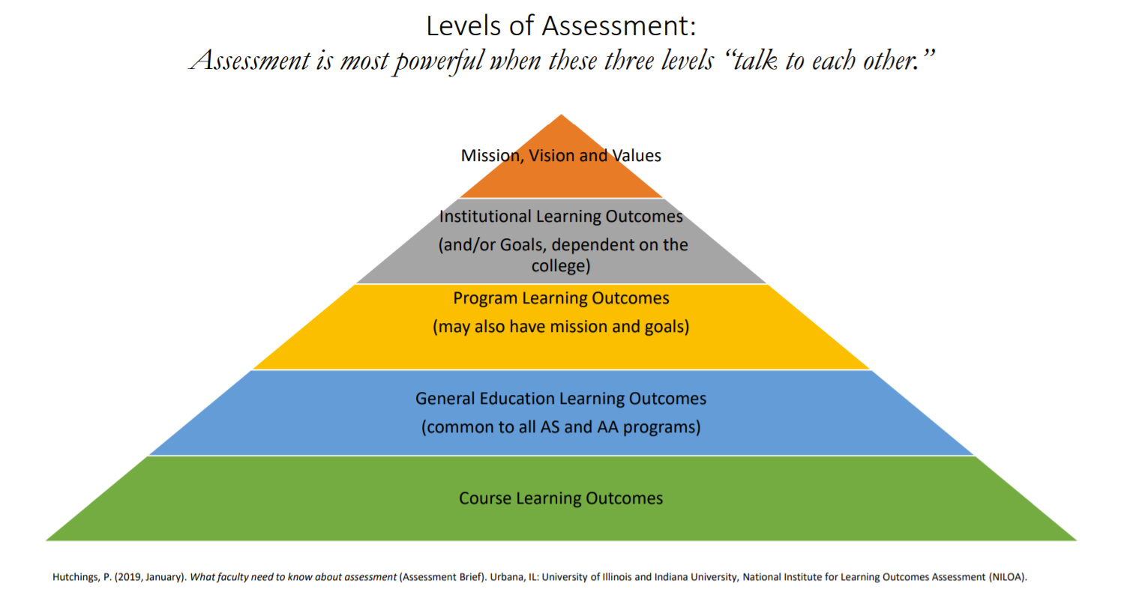
Other discussions

